Slide 1
Artificial Intelligence
One Public Servant’s Approach to Getting Started

Slide 2
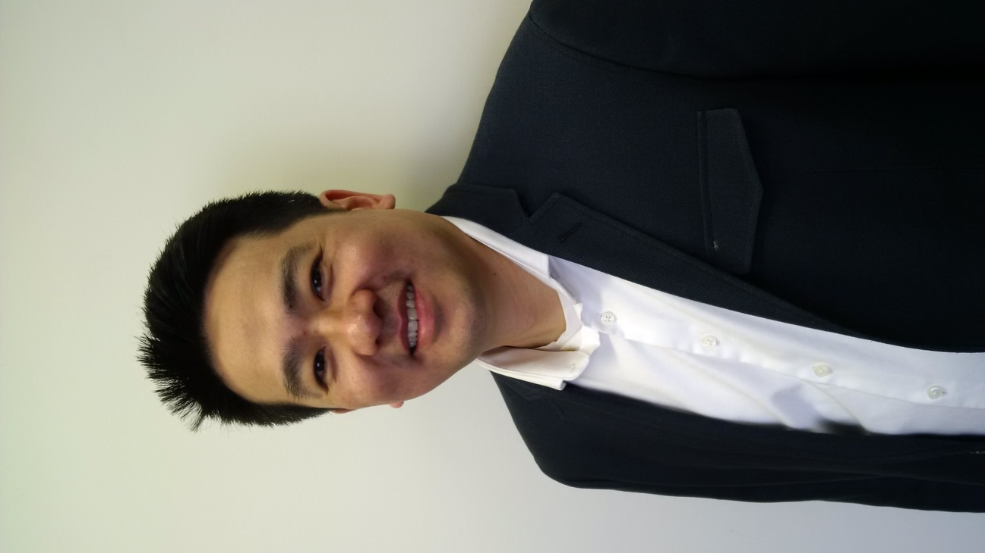
Director, Health Canada
Hieu Vu

Slide 3
Think Big
Use disruptive technologies to make public service more efficient and effective

Slide 4
START SMALL
AI to measure effectiveness of our risk communications

Slide 5
MOVE FAST
AI to supplement our consultations and public opinion research
AI to inform our openness and transparency strategy
Robotic Process Automation to free up staff time

Slide 6
Don’t start with Bright Shiny Objects
Start with a business need, not a new technology
Easier to get buy-in
Easier to get money
Fixing a problem will give you more credibility to experiment elsewhere

Slide 7
Any ideas?
Good ideas can come from anywhere
Talk to presenters, consultants, each other, anyone to get ideas
PPF – Social Media Analytics, Robotic Process Automation
Become Tinder for problems and solutions
Stay connected to other innovators to help overcome obstacles

Slide 8
Overcoming Obstacles
Business owner buy-in
Procurement
IT / Security
AI as a service first
Privacy
Analyze public data first

Slide 9
Crawl, Walk, Run
Have a scale up plan
Business Needs – Unique or generalizable
Procurement
Under $25K sole source for proof of concept
Departmental RFPs
Working with PCO Innovation Hub, TBS, PSPC to look at agile procurement
Staff
Involve the experts in your organization
Learn by doing
Absorb knowledge from consultants

Slide 10
It’s about the People
If you want to move fast, go alone. If you want to move far, go together
Understand business need – make connections
Get ideas – make connections
Overcome obstacles – make connections
Scale up - make connections

