Slide 1
A Brief History of AI [in Canada]
Keeping Up With the Speed of Disruption
Elissa Strome, Executive Director
Pan-Canadian AI Strategy, CIFAR
March 2, 2018

Slide 2
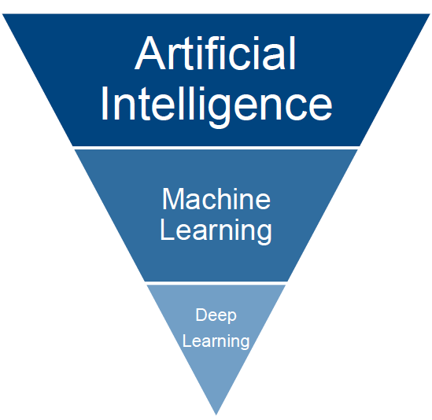
What is AI?
AI refers to computers that can learn about the world flexibly, make inferences about what they see and hear, and achieve human-like understanding of information. AI involves capacities like visual and auditory perception, the ability to read and to make sensible decisions, and the power to make accurate predictions based on existing knowledge.
Machine Learning
Machine learning algorithms give computers the power to learn and recognize patterns the way people do, without requiring specific and repetitive instructions for each new piece of data.
Deep Learning
Deep learning is a subfield of machine learning. Many other types of machine learning work well with limited data sets, but deep learning alone appears to continuously improve as the machine absorbs more and more data.
Source: A. Paprica, Vector Institute

Slide 3
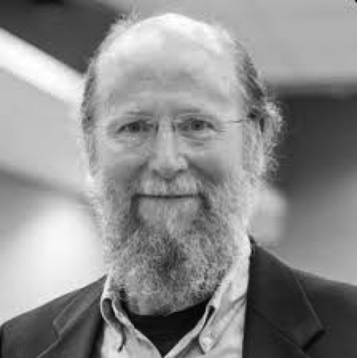
Canada’s Leadership in AI: Research Leaders

Slide 4
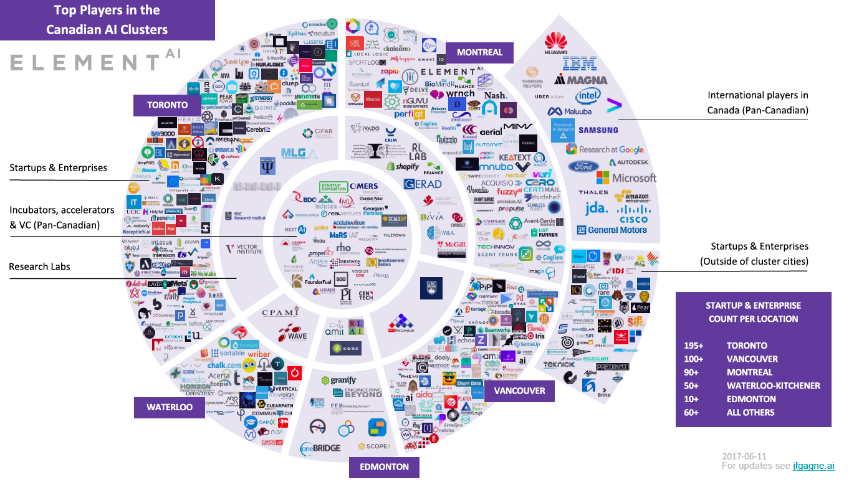
Canada’s Leadership in AI: Impact

Slide 5
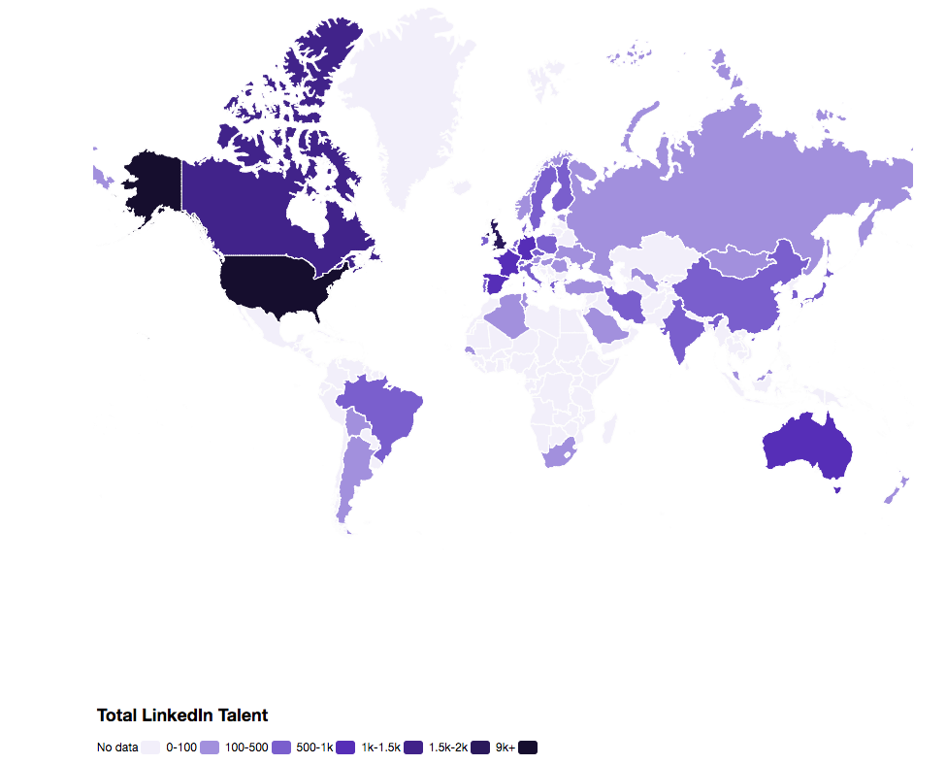
Canada’s Leadership in AI: Talent
Globally 22,000 active AI PhDs
US 9,010
UK 1,861
Canada 1,154
China underrepresented
ElementAI February 2018
Notes:
UK gov just announced a new fund for 100 PhD Studentships this year and 950 total over 5 years; by contrast Province of Ontario has invest $33M to deliver 1000AIMs by 2022; recommendation by Quebec Innovation Council to do the same

Slide 6
Canada’s Leadership in AI: The $125M Pan-Canadian AI Strategy

Slide 7
CIFAR: Advancing Excellence, Increasing Impact
CIFAR creates knowledge that enriches human life and leads to a better future for Canada and the world. We do this by connecting the world’s best minds through interdisciplinary research programs to tackle questions of global significance.
AT A GLANCE
Founded in 1982
Annual budget of $25 Million
12 interdisciplinary research programs
23 since inception
404 researchers in 16 countries
Researchers based at 133 institutions
18 Nobel laureates since inception
The very first CIFAR program in 1983 was Artificial Intelligence, Robotics and Society

Slide 8
CIFAR’s Learning in Machines and Brains: High Risk, High Reward
Launched in 2004:
The goal of the program is to understand the architecture and mechanics of the brain, and how some of its processing abilities might be replicated in digital systems. The research has become the basis for the machine learning approach known as deep learning, which is used for voice recognition, image captions, translations and many other technologies.
Geoffrey Hinton – Distinguished CIFAR Fellow - LMB Program Director 2004-14

Slide 9
CIFAR’s LMB: High Risk, High Reward

Slide 10
CIFAR’s LMB: High Risk, High Reward

Slide 11
CIFAR’s LMB: High Risk, High Reward
See the full LMB timeline of breakthroughs at: https://www.cifar.ca/research/learning-in-machine-and-brains/

Slide 12
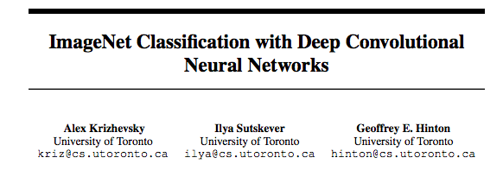
Why is Deep Learning so powerful today?
Deep learning and convolutional neural networks were established in the early 2000’s so why has this approached taken off now?
Two Main Reasons:
We are living in the age of data; the internet, sensors, smartphones
GPUs
Notes:
However, still most machine learning or computer vision researchers didnt have very favorable opinion of neural nets. At the beginning of my graduate studies, I attended around a dozen courses (2007-2011) at three different universities under fairly successful ML/CV professors and atleast three of them told us point blank that NNs were black magic. Only 3-4 groups in the world knew how to use them, and they were able to get slightly superior performance to easily reproducible methods like SVMs, so there was not much point in trying to use NNs. Thus, for most people Alex Krizhevsky's 2012 results on ImageNet classification challenge made a huge explosion. The most direct reasons for that success were two: 1. Geoff Hinton managed to get a graduate student (Alex Krizhevsky) who was superb at GPGPU programming. Remember that at this time, GPGPU tools were even less mature than they are now, and very few people knew how to use GPU effectively for non-graphics computation. 2. ImageNet was the first computer vision dataset to comprise of millions of labeled images, and it had just become available. Once he showed this massive quantitative improvements on an extremely challenging problem, it became impossible for the community to neglect deep NNs. Anyways around the same time Nvidia significantly improved CUDA, and comparably large datasets in other domains also became available.

Slide 13
CIFAR’s LMB Today
+ 41 more across Computer Science, Neuroscience, Bioinformatics & Computational Biology
Supported by:
Notes:
Has been renewed twice in 2008 and 2014

Slide 14
What are the opportunities? Transportation
Notes:
This is work from Raquel Urtasun at the University of Toronto and Vector Institute and also now leading Uber’s research lab in Toronto.

Slide 15
What are the opportunities? Healthcare
Notes:
So many of the examples coming out of Deep Leaning adoption are in health care right now, including genetics, personal health data, etc.
Radiology is one of the best examples; here is a a study that was published last week by UdeM researchers showing

Slide 16
What are the opportunities? Security
“Real life consists of bluffing, of little tactics of deception, of asking yourself what is the other man going to think I mean to do.”— John von Neumann, founder of game theory
Notes:
Artificial intelligence has seen several breakthroughs in recent years, with games often serving as milestones. A common feature of these games is that players have perfect information. Poker, the quintessential game of imperfect information, is a long-standing challenge problem in artificial intelligence. We introduce DeepStack, an algorithm for imperfect-information settings. It combines recursive reasoning to handle information asymmetry, decomposition to focus computation on the relevant decision, and a form of intuition that is automatically learned from self-play using deep learning. In a study involving 44,000 hands of poker, DeepStack defeated, with statistical significance, professional poker players in heads-up no-limit Texas hold’em. The approach is theoretically sound and is shown to produce strategies that are more difficult to exploit than prior approaches.
The principles behind DeepStack may enable advances in solving real-world problems that involve assymetry
These are just three recent examples from Canada, but there are so many more critical opportunities, including lots of things that are important to businesses and consumers, but also lots of things that are important to governments: cybersecurity, education, supply chain, customer and sentiment analysis, safety, etc.

Slide 17
Canada’s Leadership in AI: The Pan-Canadian AI Strategy
4 Goals
Research excellence
Bring the best researchers from around the world to Canada
Development of outstanding AI talent
Foster collaboration across the country via three Centres of Excellence
Develop global thought leadership on the economic, ethical, policy and legal implications of advances in AI
4 Major Activities
Establish core-funding for AI Institutes
50 Canada CIFAR Chairs in AI
Pan-Canadian workshops, conference, summer schools, etc.
AI & Society Program (international in scope)

Slide 18
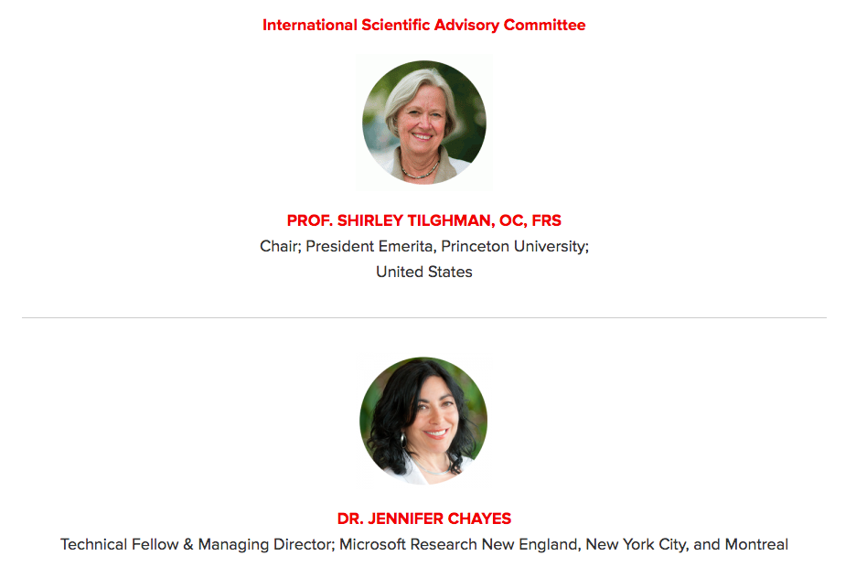
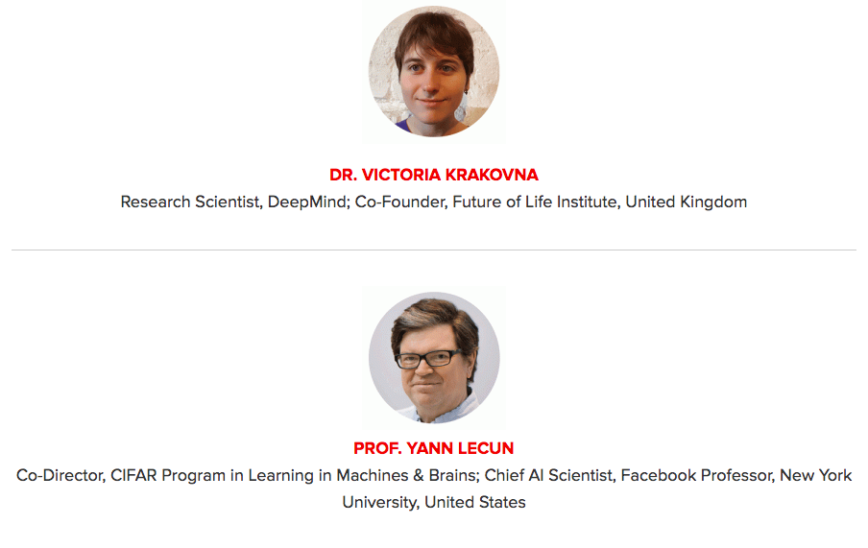
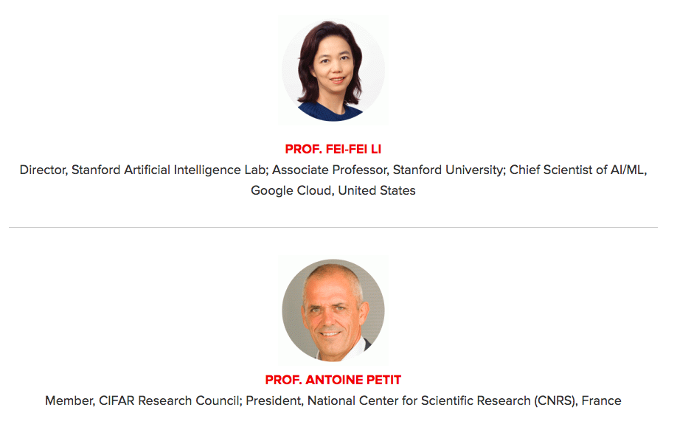
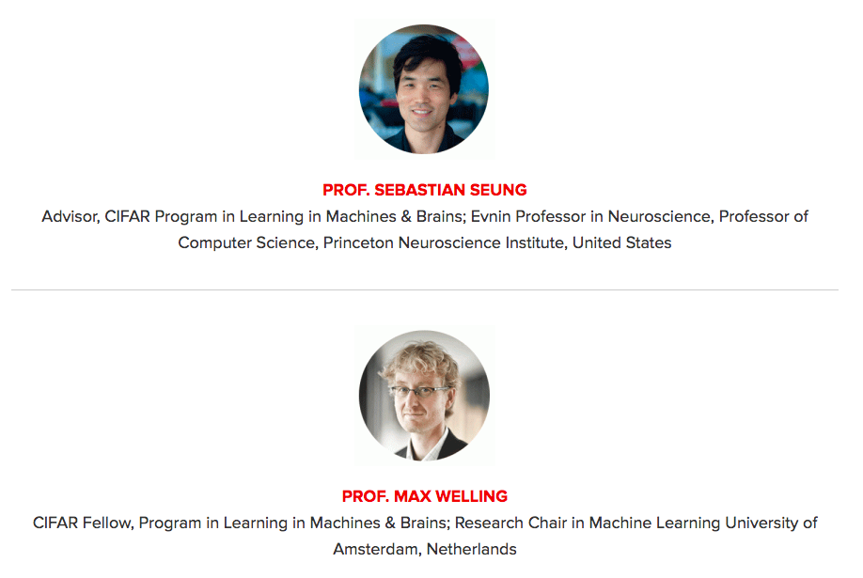
Canada CIFAR AI Chairs: International Scientific Advisory Committee

Slide 19
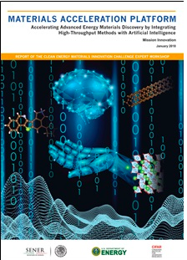
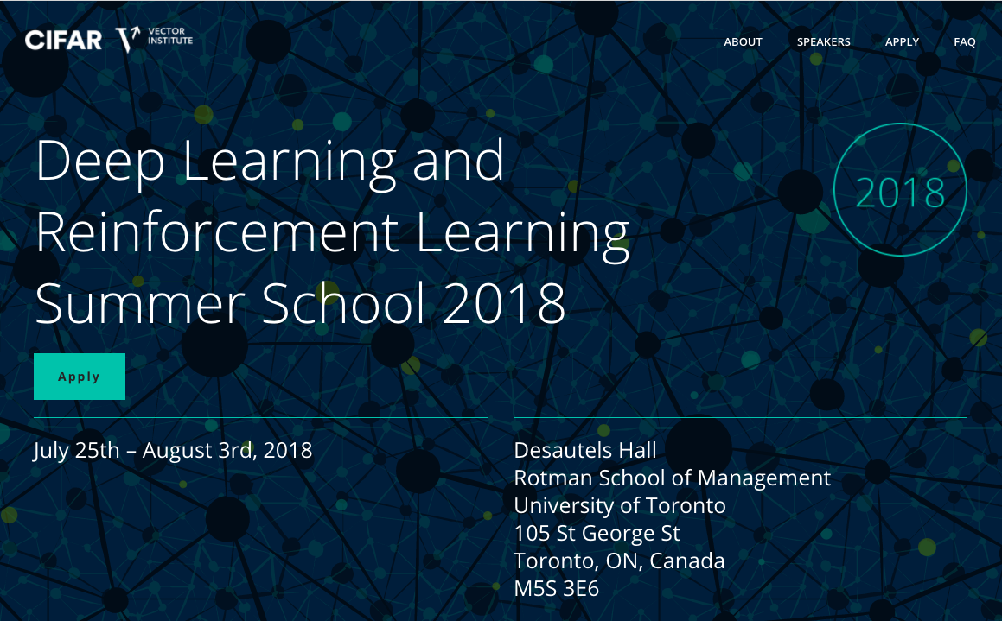
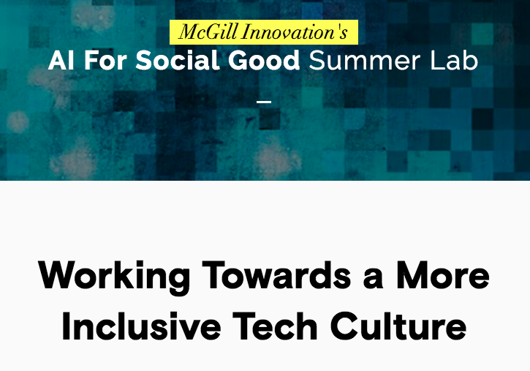
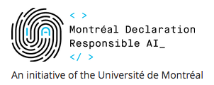
Pan-Canadian Activities

Slide 20
CIFAR AI & Society Program
Call for Workshops – opens March 31
bring together international groups of researchers and practitioners to explore some of the biggest questions in AI from ethical, legal, economic, and social perspectives
CIFAR AI & Society Policy Labs
convene early career policy innovators to undertake foresight explorations and develop thought-provoking future scenarios for the implications of AI on the policy landscape

Slide 21
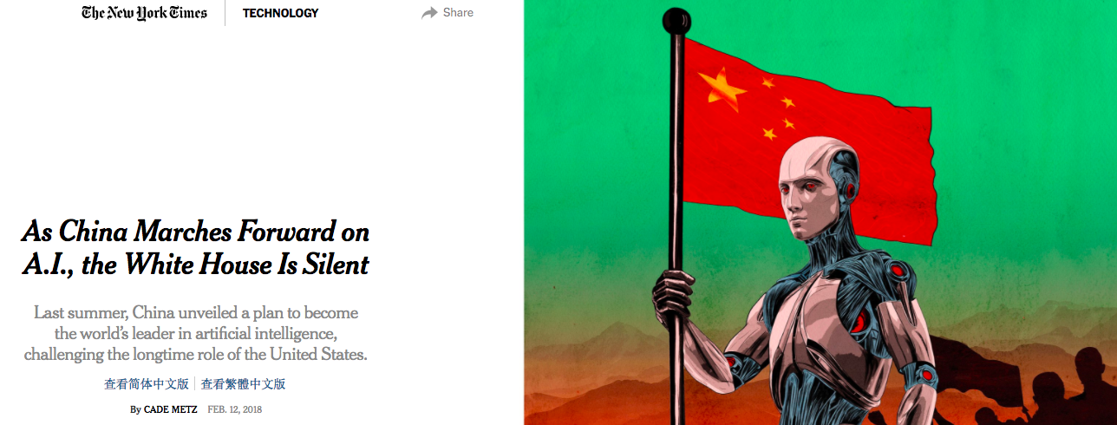
Challenges We Will Face

Slide 22
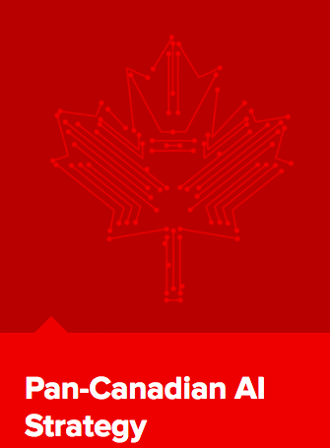
Three Thoughts
Machine learning is transforming all aspects of human activity that generate large amounts of data, from finance to transportation, health to agriculture, with the potential for tremendous positive social, economic and environmental impact.
Canada and CIFAR have a long history of pioneering transformative research in AI and machine learning.
The Pan-Canadian AI Strategy will help to cement Canada’s leadership position and establish a vibrant ecosystem of cutting edge research and talent development.

Slide 23
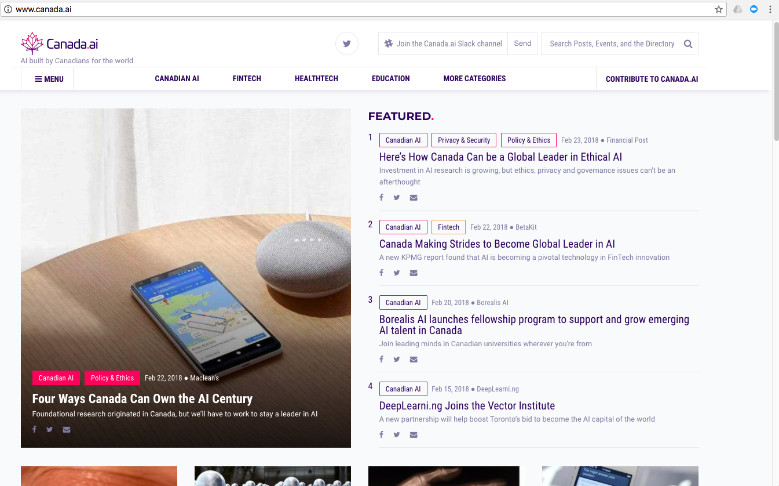
Resources: Canadian AI scene and Intro to DL

Slide 24
Resources: Canadian AI scene and Intro to DL
Podcasts:
The AI Effect: https://theeffect.ai/
Machine Learning Guide: http://ocdevel.com/podcasts/machine-learning
No shortage of good overviews in the news media:
Macleans
MaRS Magazine – the Future of AI
5 Free Exhaustive And Comprehensive Resources To Learn Deep Learning From Scratch

Slide 25
Thank You

Slide 26
Group Discussion:
What excites you the most about the promise of machine learning? (In both your personal and professional life).
What are some of the processes, procedures and functions of your department that could benefit from adopting machine learning approaches? What work have you already begun?
Why is Canada’s leadership in AI so important and what more can we do to retain our position?
Notes:
Weather forecasting
Siri/Alexa/google home
Google translate

