Slide 1
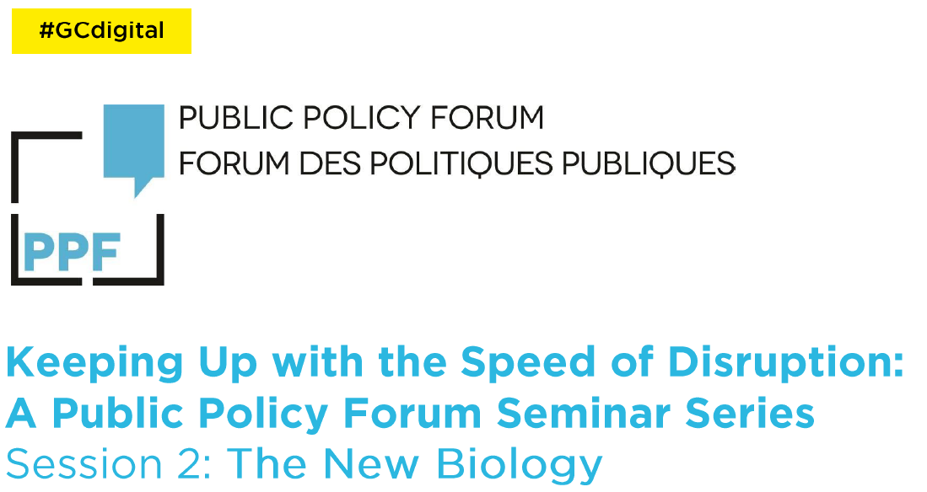
Disruption in the Life Sciences – gene editing, synthetic biology and beyond
Rob Annan, PhD
Vice-President, Public Affairs and Communications
Genome Canada

Slide 2
The Genome
Notes:
Photo credit shutterstock
This is the genome. DNA, made up of basepairs, two complementary strands. We all have it and its at the center of pretty much everything we’re going to talk about today.
But before we jump right into that, we’re going to do a whirlwind review of grade 12 biology so that we’re all on the same page

Slide 3
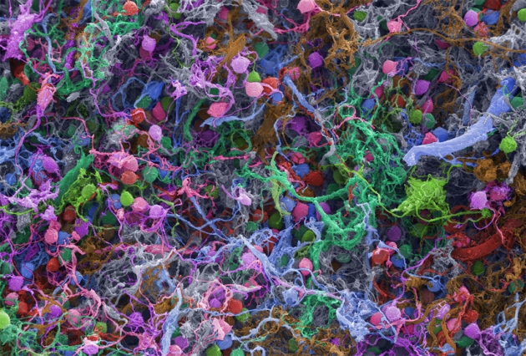
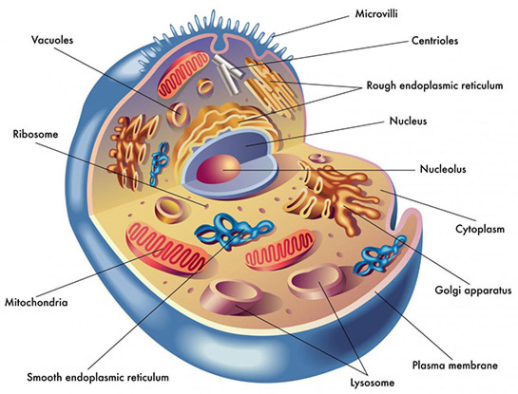
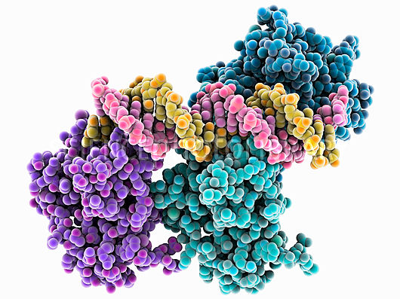
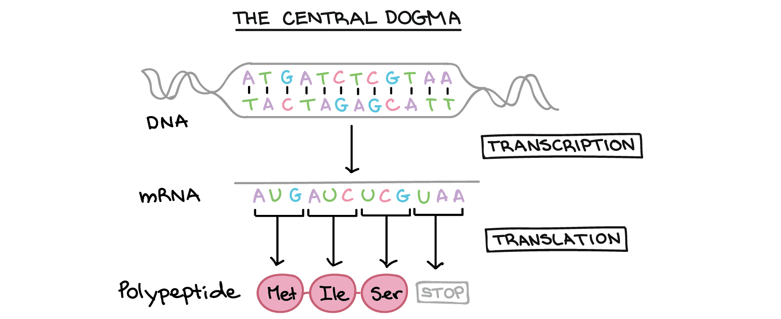
c/o Ted Kinsman/SPL/Nature
c/o Healthguidance
c/o Shutterstock
c/o Science Design
c/o Khan Academy
Notes:
This is you.
You are made up of cells. These are brain cells.
This is what animal cells look like in biology textbooks, with all the various subcompartments that are the factories of the cell and allow it to be a neuron, or skin cell or liver cell, etc.
The machines that drive production of the cell and its central activities are called proteins. They are a major building block of cells. They are made of amino acids that fold in infinite shapes that then interact with each other and other molecules to achieve all sorts of functions. They’re the workers of the cell.
Cells know how to make proteins because they have a blueprint – DNA. The code in DNA corresponds to the code in proteins. The DNA code is linear and compact. The corresponding amino acid code is charged and big and folds and achieves all the interesting shapes and movements that make life possible.
Which brings us back to DNA

Slide 4
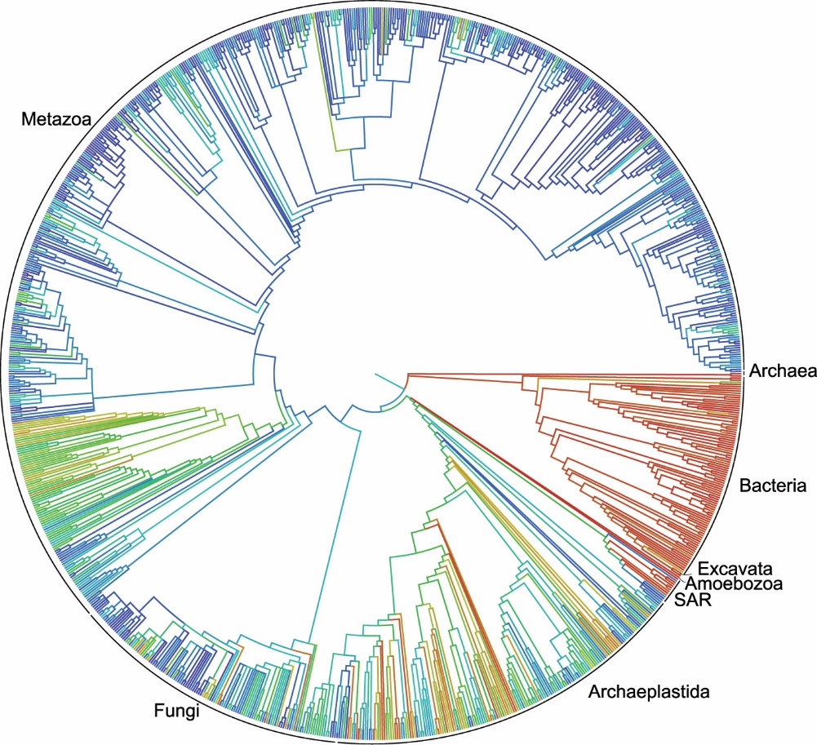
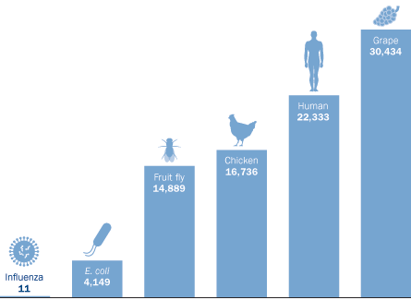
Genetic Diversity
https://www.sciencenews.org
Notes:
2.3 million of your closest ancestral species

Slide 5
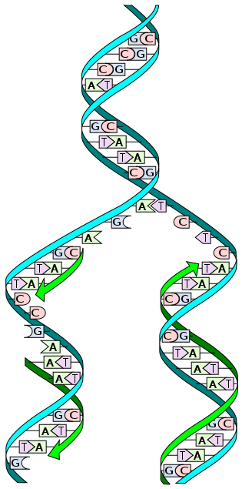
Rare errors in DNA replication lead to genetic variability
Notes:
DNA replication creates two copies of DNA which are passed on to the offspring. Rarely, there are mistakes made in the replication. Even more rarely, those mistakes are reflected in proteins that suddenly work differently or in the areas that regulate how much of those proteins are produced, or when. Even more rarely, those differences have a phenotypic effect that either increases or decreases the odds of survival for that individual. Since replication rarely makes mistakes, mutations that provide an advantage in survival are more likely to be passed on, meaning there is a positive selection for those mutations. This is natural selection. Here we see two examples – the peppered moth in Great Britain that, during the Industrial Revolution, changed its shading to a grey colour. And the mighty giraffe, whose necks evolved to reach higher leaves in search of scarce nutrition on the savannah. The giraffe genome has been sequenced and by comparing it with close relatives, it’s been determined that mutations in roughly 70 genes are responsible.

Slide 6
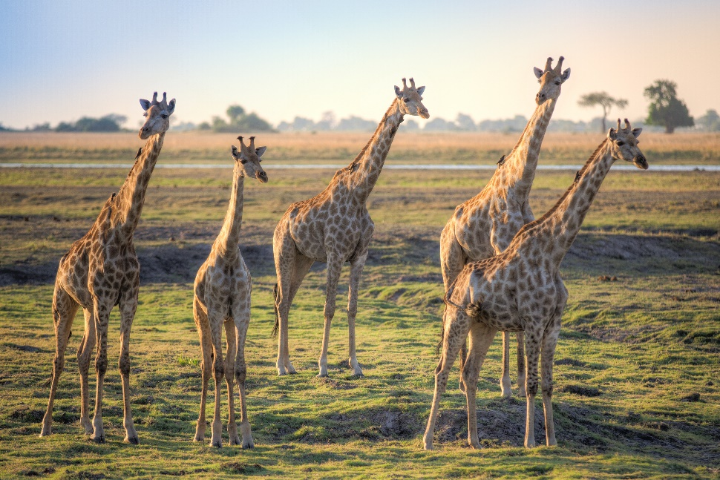
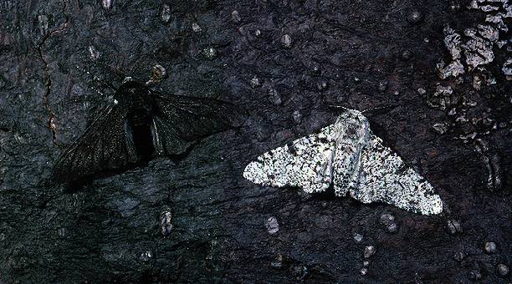
Rare errors in DNA replication lead to genetic variability
Natural Selection
Notes:
Artificial selection, also known as selective breeding. Selection for given traits and reinforcement of those traits over generations. You select for the phenotype you want, so indirectly selecting for specific genes or sets of genes. But also selecting for lots of other genes by accident. So you end up with high yield plants with disease susceptibility or you end up with dog breeds that have trouble with hips or breathing or whatnot. But either way, it’s genetic changes for phenotypic traits.

Slide 7
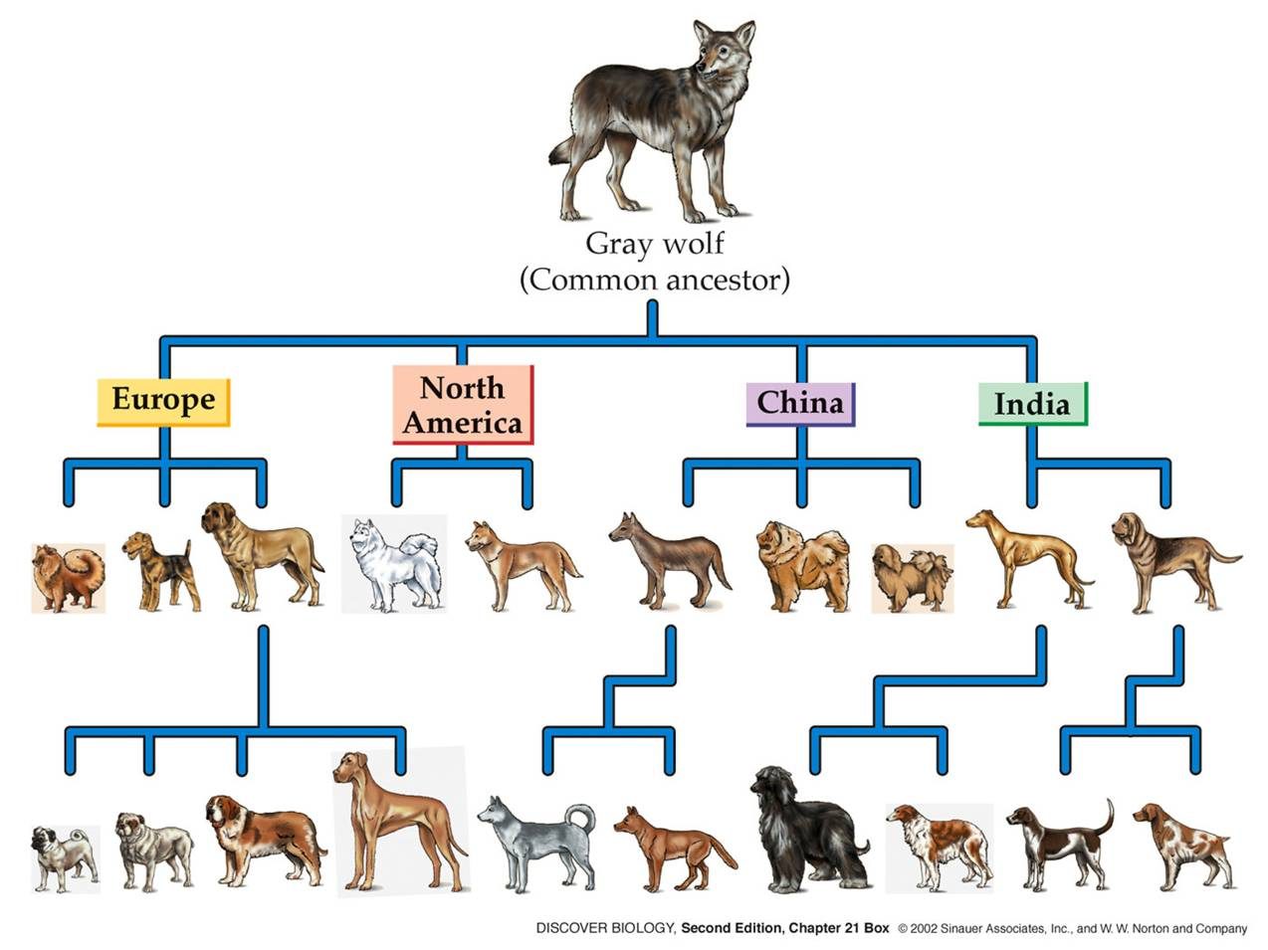
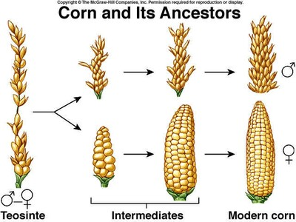
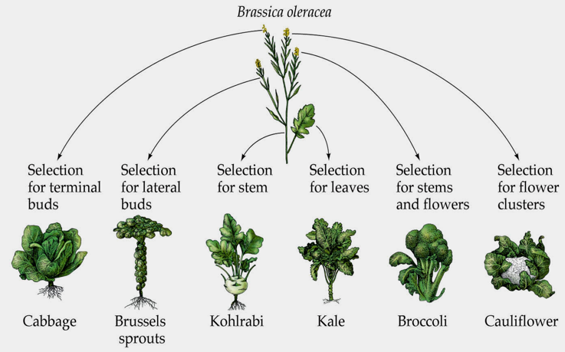
Natural Selection
Artificial Selection
Notes:
Artificial selection, also known as selective breeding. Selection for given traits and reinforcement of those traits over generations. You select for the phenotype you want, so indirectly selecting for specific genes or sets of genes. But also selecting for lots of other genes by accident. So you end up with high yield plants with disease susceptibility or you end up with dog breeds that have trouble with hips or breathing or whatnot. But either way, it’s genetic changes for phenotypic traits.

Slide 8
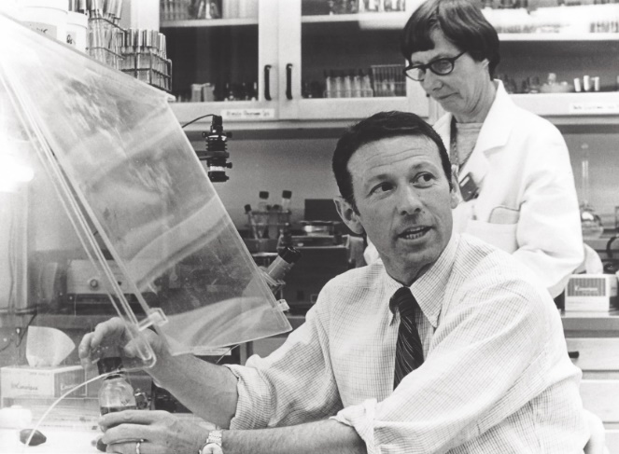
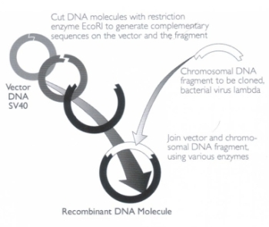
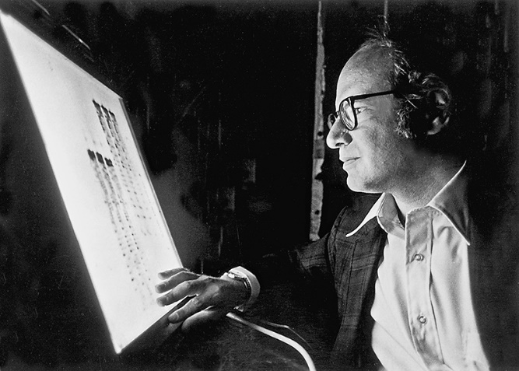
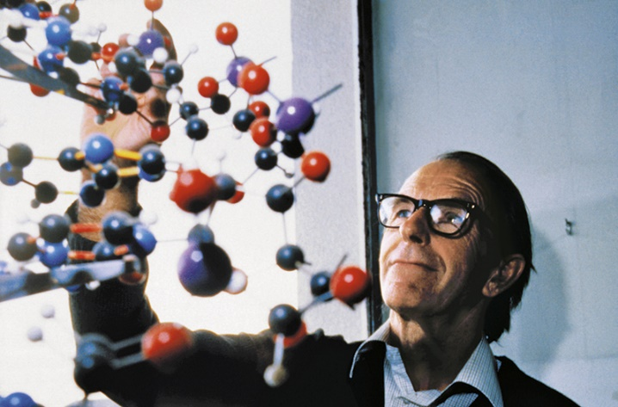
The Birth of Biotechnology – 1970s
Paul Berg, Stanford, 1971 gene-splicing experiment
Wally Gilbert and Fred Sanger, 1970s DNA sequencers
Two ingredients for biotechnology: genetic sequencing and genetic manipulation (gene editing)
Notes:
technically, even early plant breeding can be considered biotechnology – the adaptation of living systems for human needs.
Throughout the 19th and 20th centuries, biotechnology has developed as we’ve learned more about cell theory, biochemistry, medicine and more.
But it’s really in the last few decades that biotechnology has taken off.
Modern biotechnology was born in 1971 at Stanford with Paul Berg’s gene splicing experiment – where he inserted DNA from the lambda virus into the SV40 virus making recombinant DNA.
Appropriately, Berg shared the 1980 Nobel Prize in Chemistry with Gilbert and Sanger

Slide 9
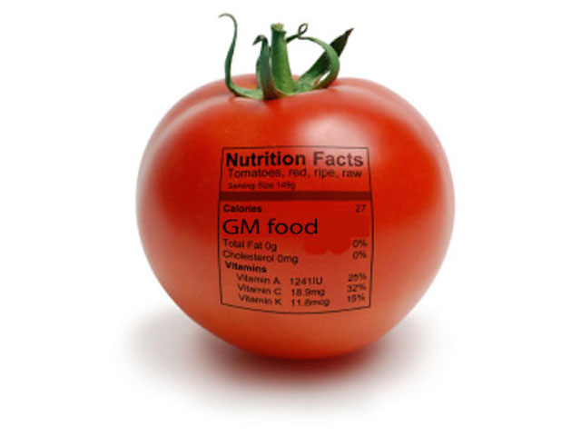
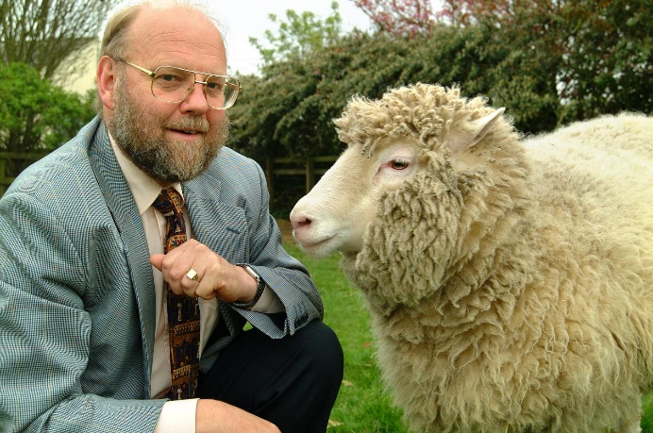
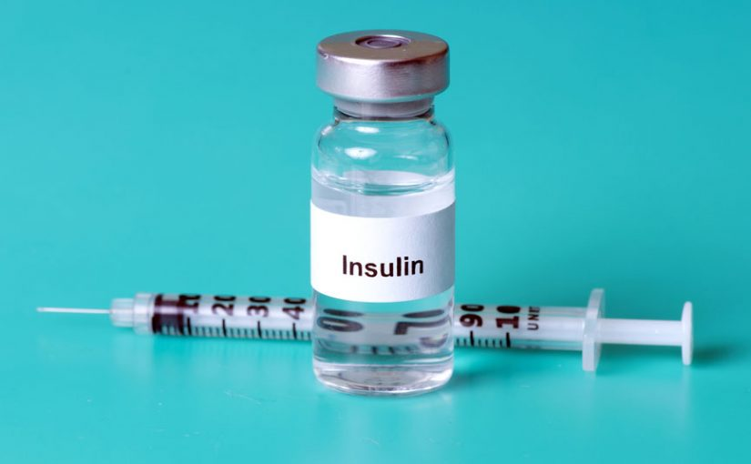
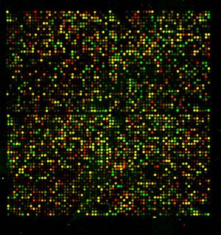
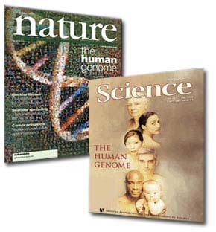
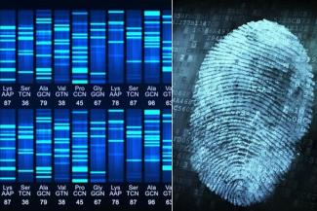
Biotech – the early years
Notes:
2001 – the end of the beginning

Slide 10
Biotech Today – What’s Changed?
Sequencing Power
Gene editing tools

Slide 11
What’s changed? Sequencing Power

Slide 12
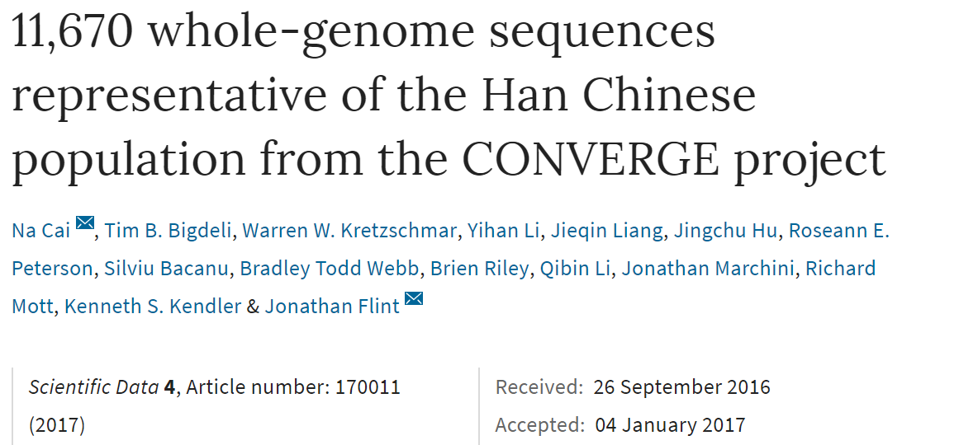
What’s changed? Sequencing Power

Slide 13
What’s changed? – Gene editing

Slide 14
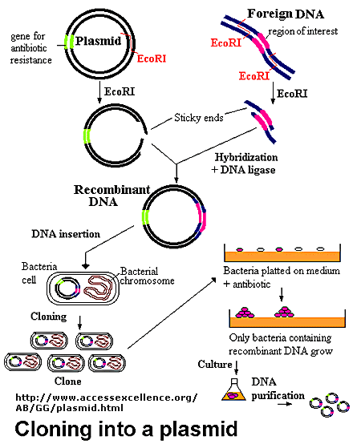
Gene editing – the early days
Paul Berg, Stanford, 1971 gene-splicing experiment
Notes:
technically, even early plant breeding can be considered biotechnology – the adaptation of living systems for human needs.
Throughout the 19th and 20th centuries, biotechnology has developed as we’ve learned more about cell theory, biochemistry, medicine and more.
But it’s really in the last few decades that biotechnology has taken off.
Modern biotechnology was born in 1971 at Stanford with Paul Berg’s gene splicing experiment – where he inserted DNA from the lambda virus into the SV40 virus making recombinant DNA.
Appropriately, Berg shared the 1980 Nobel Prize in Chemistry with Gilbert and Sanger

Slide 15
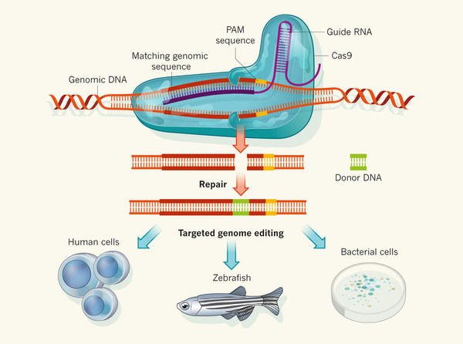
CRISPR-Cas9 – a highly specific genome editor

Slide 16
CRISPR-Cas9 – a highly specific genome editor
Knock genes out – disable them
Precisely replace genes or insert new ones
Increase or decrease expression of genes
Faster, cheaper, more accurate, more efficient.

Slide 17
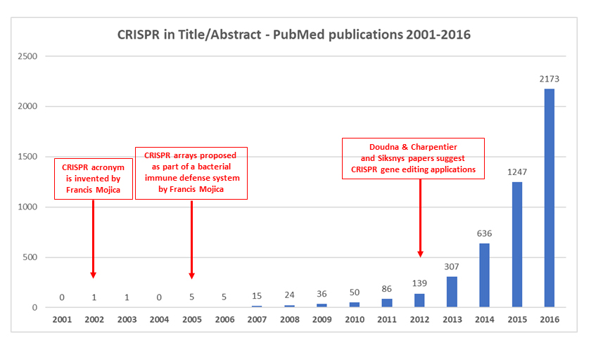
CRISPR-Cas9 explosion
http://wwwuser.cnb.csic.es/~montoliu/CRISPR/
*Over 3000 mentions in 2017

Slide 18
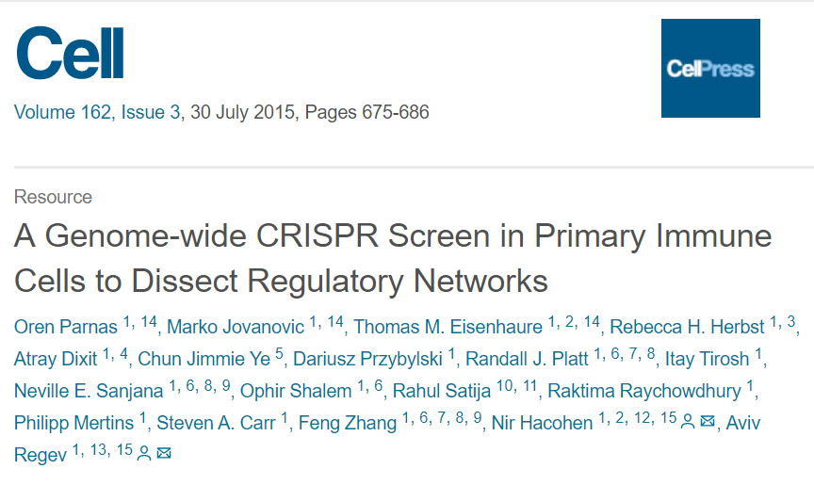
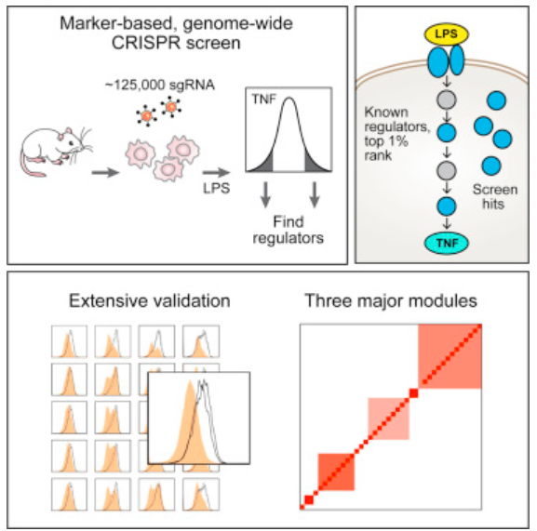
What’s the fuss? - Science
Fantastic research tool - knock out individual genes at high efficiency

Slide 19
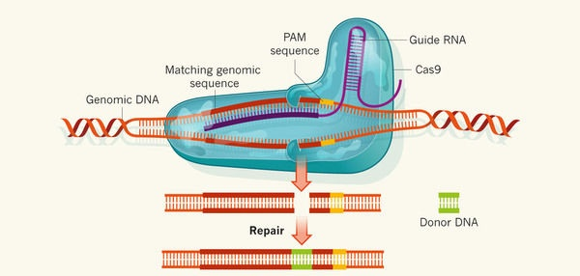
What’s the fuss? - Health

Slide 20
What’s the fuss? - Health
Replace with nonmutated disease gene, eg CFTR
Remove viral DNA, eg. HIV
Add cancer fighting gene, eg T cells

Slide 21
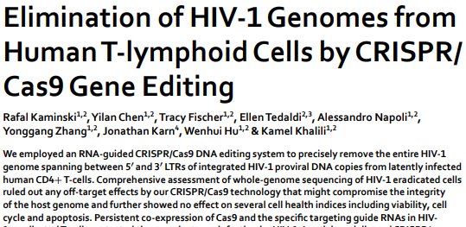
What’s the fuss? - Health
Replace with nonmutated disease gene, eg CFTR
Remove viral DNA, eg. HIV
Add cancer fighting gene, eg T cells

Slide 22
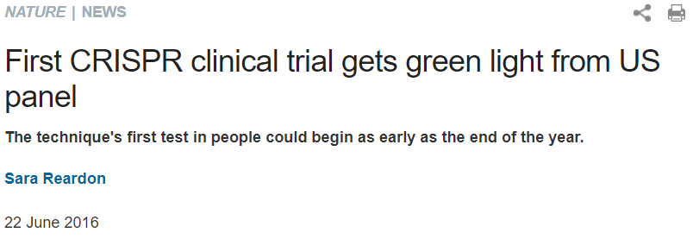
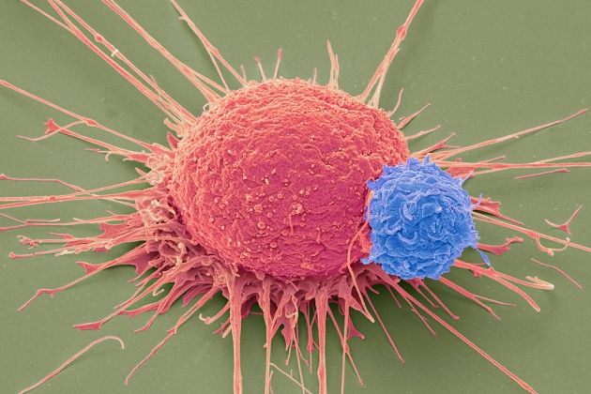
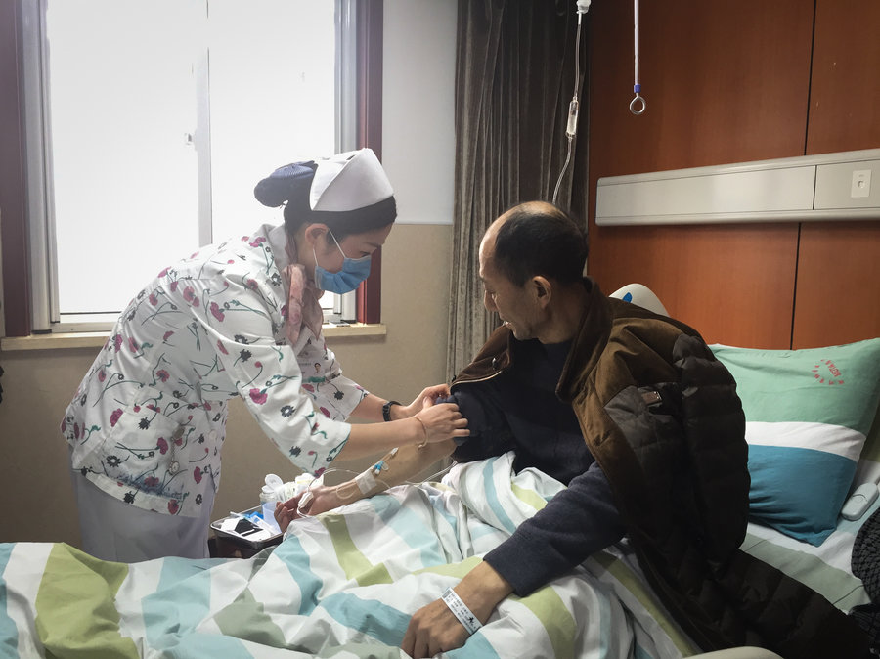
Moving fast
Notes:
Upennsylvania now recruiting patients for a study in which cancer patients will have their immune cells (T cells) removed, three CRISPR edits on them. One edit will insert a gene for a protein engineered to detect cancer cells and instruct the T cells to target them, and a second edit removes a natural T-cell protein that could interfere with this process. The third is defensive: it will remove the gene for a protein that identifies the T cells as immune cells and prevent the cancer cells from disabling them. The researchers will then infuse the edited cells back into the patient.
Wall Street Journal reported late last year that 86 patients have been treated with CRISPR therapies. Nothing published yet, but doctors told reporters a number improved significantly, while others died – though all seemed to die of the diseases they were being treated for.

Slide 23
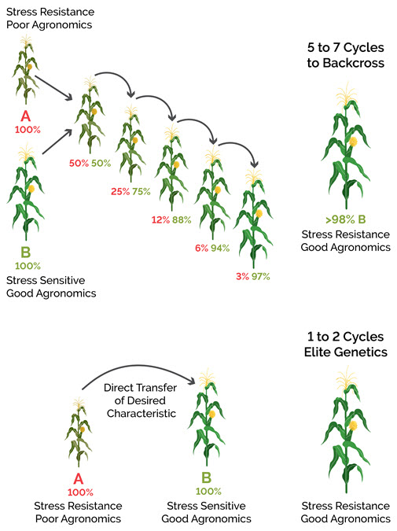
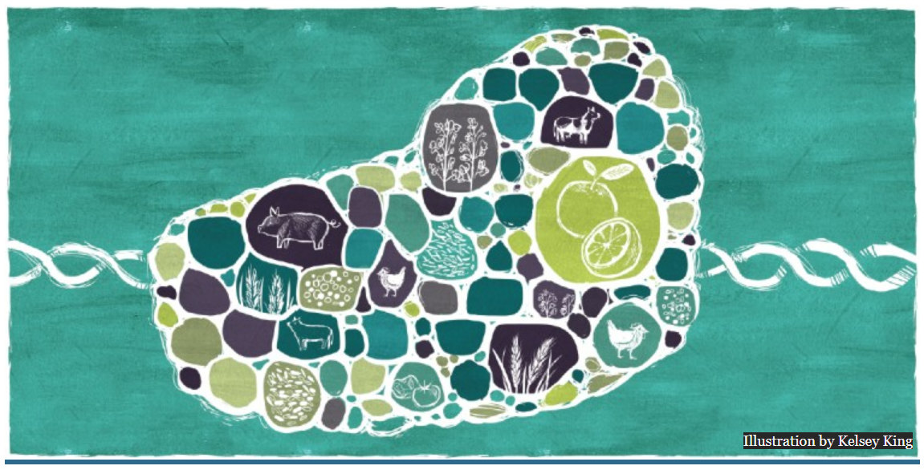
What’s the fuss? – Agriculture and Natural Resources
http://ensia.com
Ability to select for desired intraspecific traits without loss of other traits
Potential to decrease application of antibiotics
DupPont Pioneer
Notes:
Huge implications for agriculture.
DuPont Pioneer already developed corn on market in China
Divseek and genetic diversity. Drought resistance

Slide 24
The future is here
Genetic diseases
More than 10,000 diseases are due to mutations to a single gene
Viral diseases
Cancer
Forestry, agriculture, environment
Climate change mitigation and adaptation
Increased yields
Reduced pesticides and antibiotics
Enhanced opportunities for synthetic biology
Notes:
Cystic Fibrosis, Sickle-cell anemia, Huntington’s disease, rare diseases
HIV, hepatitis B, other viruses
Cancers – engineered immune cells as well as direct attacks on cancer mutations
Synthetic biology - biosensors

Slide 25
CRISPR 2.0 – the future?
What about genetic disease elimination in the germline?
What about ‘vaccines’ for potential diseases?
What happens when we move from disease to vanity traits?
Eyesight? Baldness/greyness? More?
What if we can start to address genetic changes associated with aging?
Gene drive

Slide 26
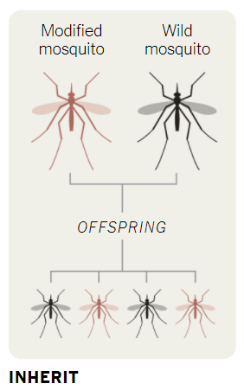
Gene Drive
Notes:
Apply technique to 1% of wild mosquitoes and can eradicate malaria within the year
Rats in NZ or Galapagos

Slide 27
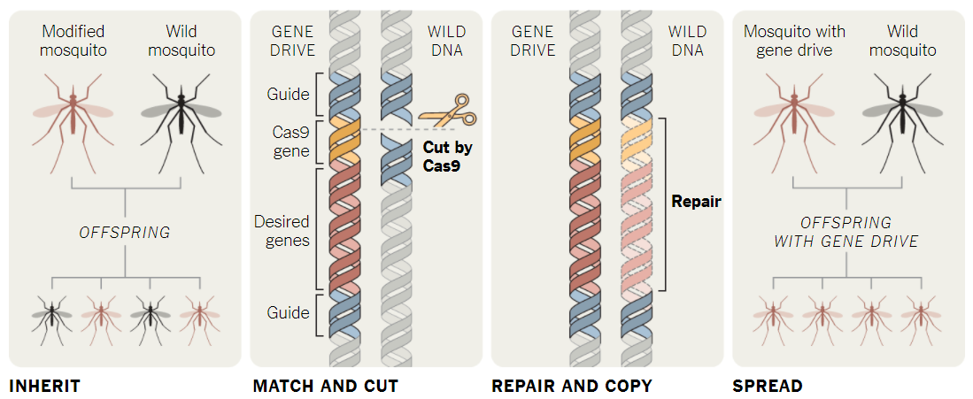
Gene Drive
Disease vectors/mosquitoes – malaria, dengue fever, Lyme disease
Invasive species
Environmental implications, ethical implications
Notes:
Apply technique to 1% of wild mosquitoes and can eradicate malaria within the year
Rats in NZ or Galapagos

Slide 28
Policy Challenges
How to stay on top of fast-moving science
Old policies won’t fit new technologies in health, food, environment
Balance between innovation and regulation
Education and public engagement on complicated science

Slide 29
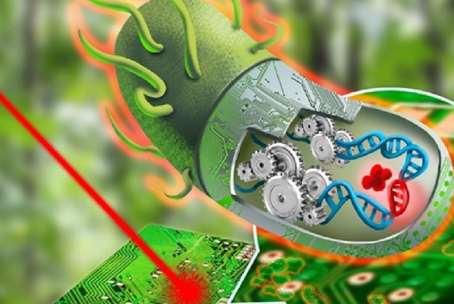
Synthetic Biology
Photo Credit: Illustration by Eric Proctor and Autumn Kulaga

Slide 30
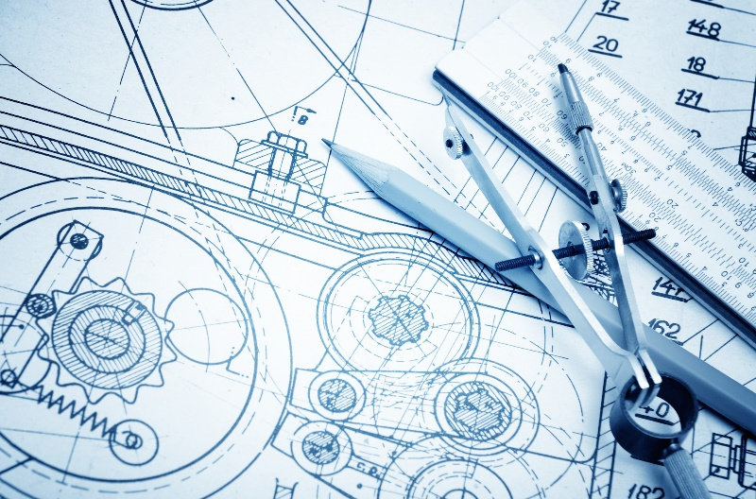
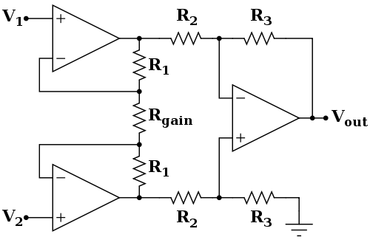
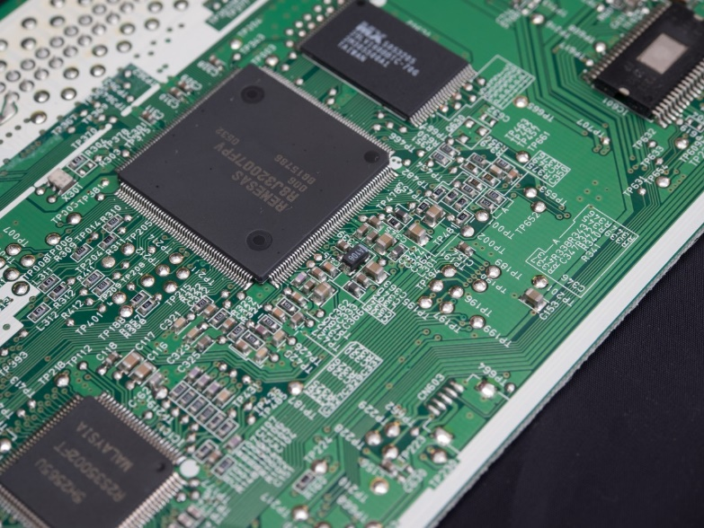
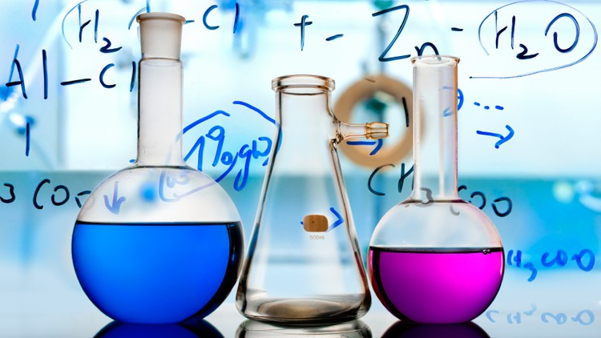
Synthetic biology is an emerging scientific field that applies engineering principles to design and assemble biological compounds and systems
Notes:
Synthetic biology builds on what we’ve been talking about, but more.
Development of biological systems for applied ends

Slide 31
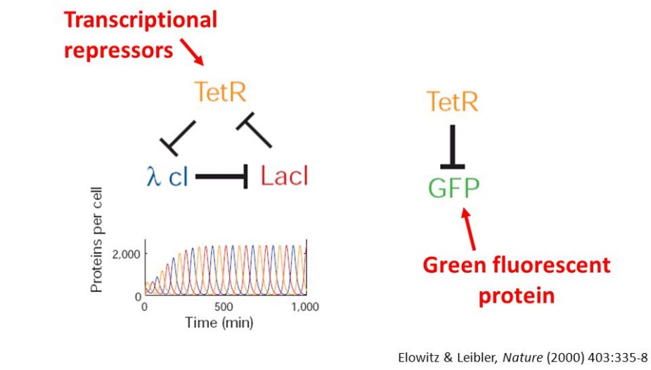
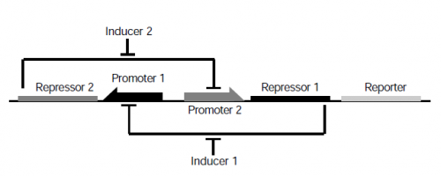
Synthetic Biology – a background

Slide 32
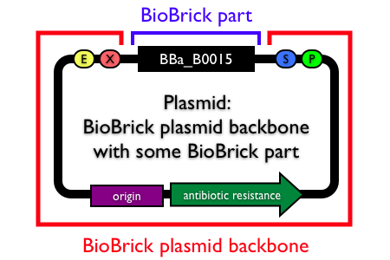
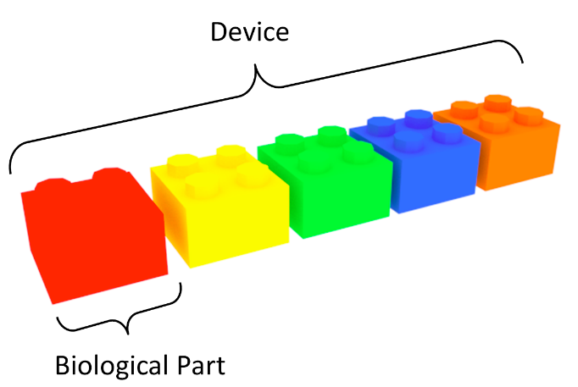
Since 2000, development of a toolkit
Sensors – light, heat, molecular signals, mechanical stress
Switches, logic gates – repressors, activators, amplifiers
Inter/intracellular communication – within and between cells
Outputs – fluorescence, molecules, motility,
Notes:
iGEM – thousands of parts that can be dropped into BioBrick backbone

Slide 33
Synthetic Biology in practice

Slide 34
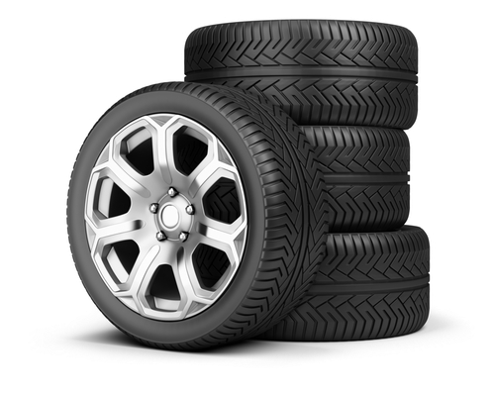
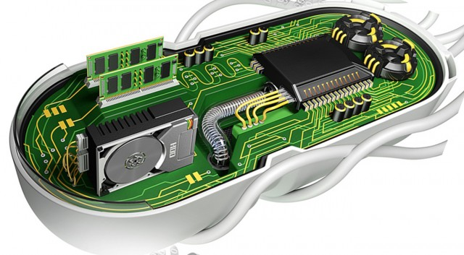
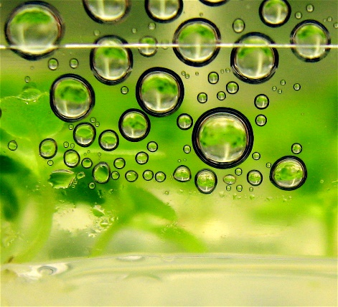
Synthetic Biology in Practice
Notes:
Synthetic rubber comes from petrochemicals – DuPont and Goodyear are using yeast to mass produce a plant enzyme from the rubber tree, hoping to eliminate petrochemicals
All 154 of Shakespeare’s sonnets in DNA

Slide 35
Synthetic Biology in Practice
Notes:
Synthetic rubber comes from petrochemicals – DuPont and Goodyear are using yeast to mass produce a plant enzyme from the rubber tree, hoping to eliminate petrochemicals
All 154 of Shakespeare’s sonnets in DNA

Slide 36
Synthetic Biology – what comes next?

Slide 37
Policy Challenges
Enormous potential
Regulatory challenges
Biohacking – positives and negatives
Bioterrorism – eg smallpox
Informal controls falling away
Align social with the technical research
GE³LS
Genomics and its Ethical, Economic, Environmental, Legal and Social Issues

Slide 38
Thank you and good luck.
Rob Annan
rannan@genomecanada.ca
@robannan

